Slide 1
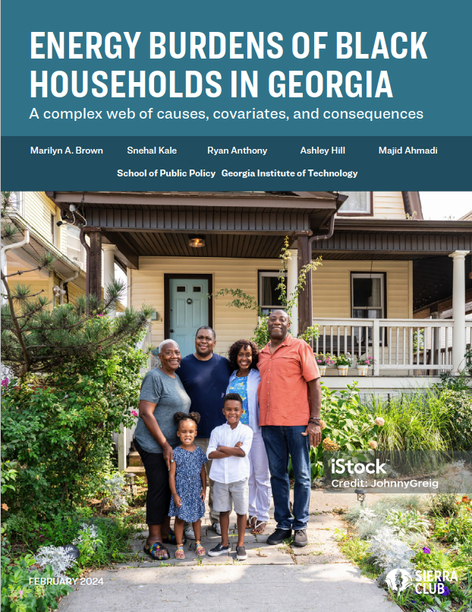
Energy Burden Forum
Sierra Club Georgia Chapter Senior Communications & Policy Coordinator Ricky Leroux.
Thursday, August 8, 2024 @ 7pm ET
Highlights the oversized energy burdens faced by black households in Georgia.
“Black households face disproportionately high energy burdens, including historic discrimination and disinvestment in infrastructure.”
Sharonda Williams-Tack,
original Sierra Club project manager who is now at US DOE.
Notes:
Include in presser
Definitions of energy burden, energy insecurity, energy poverty from ORNL Report: Low-Income Energy Affordability Conclusions from a Literature Review (2019).
For a particular area, the energy burden can be measured based on the mean or median income of households in that area.

Slide 2
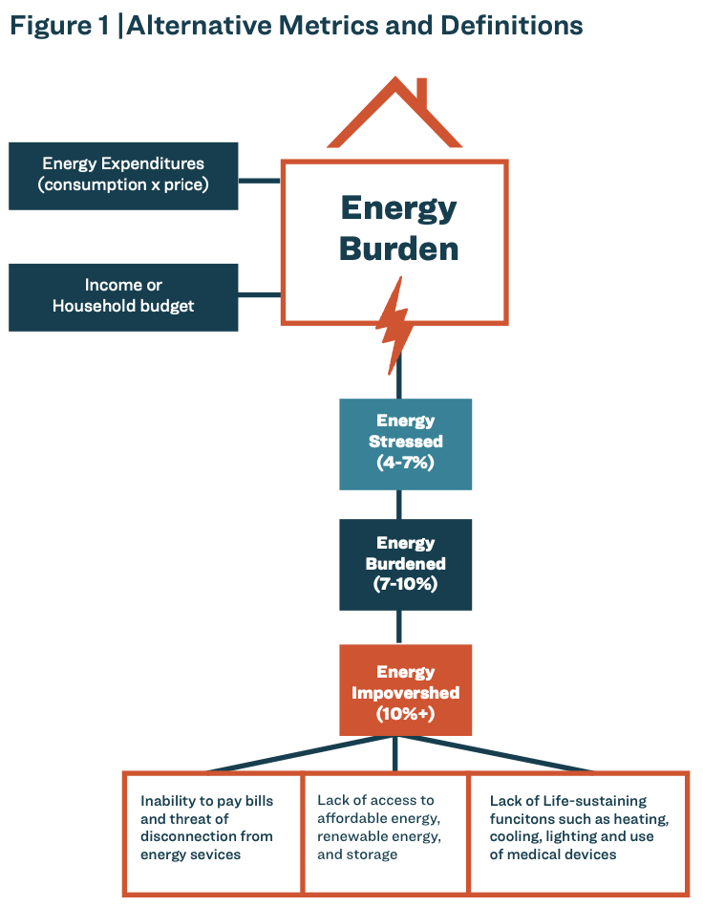
What is Energy Poverty?
To be explained by Ansel Ahabue (Georgia Tech)
Energy Burden measures the portion of income that a household spends on electricity, natural gas, and other household fuels such as propane and wood.
Energy Poverty occurs when a household spends 10% or more of their income on energy.
The consequences of energy poverty can be harmful.
Notes:
Include in presser
Definitions of energy burden, energy insecurity, energy poverty from ORNL Report: Low-Income Energy Affordability Conclusions from a Literature Review (2019).
For a particular area, the energy burden can be measured based on the mean or median income of households in that area.

Slide 3
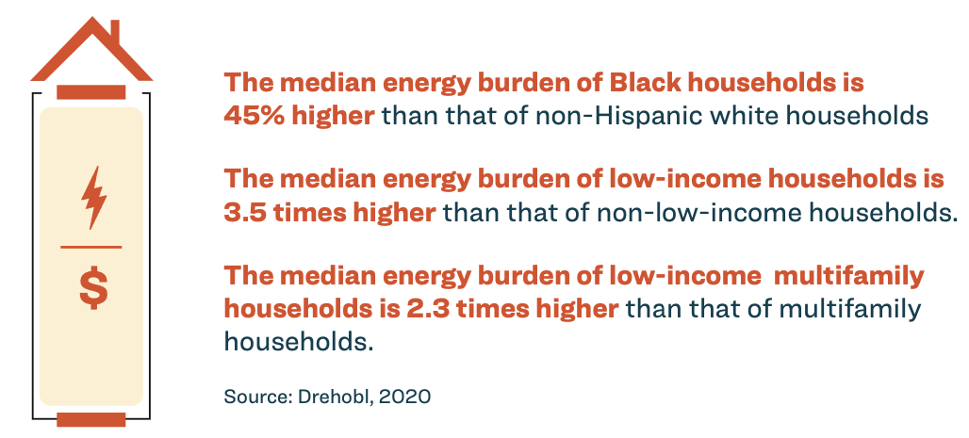
Key U.S. energy burden facts
Notes:
Include in presser

Slide 4
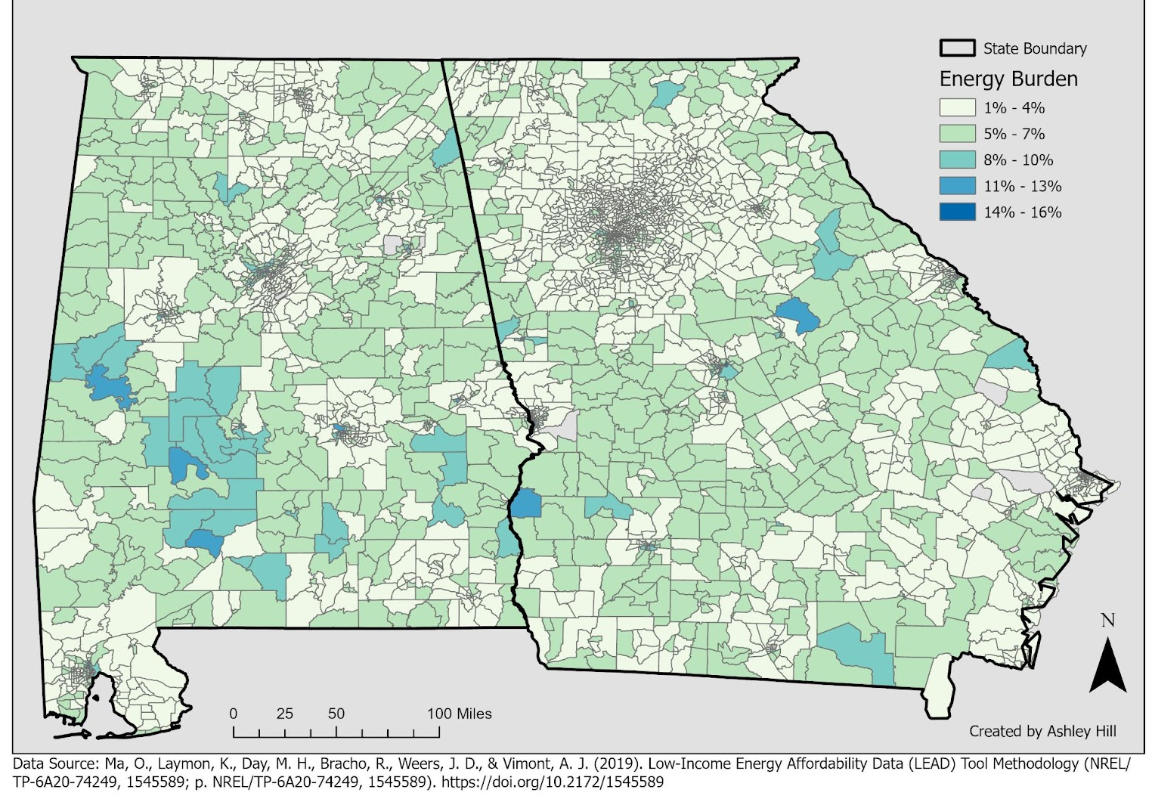
Energy Burden by Census Tract (2018): Alabama and Georgia
Energy burden in
Alabama and Georgia:
The “Black belt” is home to many neighborhoods with high energy burdens
It stretches across Alabama and Georgia and beyond and highlights the problem of rural energy poverty
Notes:
THIS SLIDE HAS ANIMATIONS

Slide 5
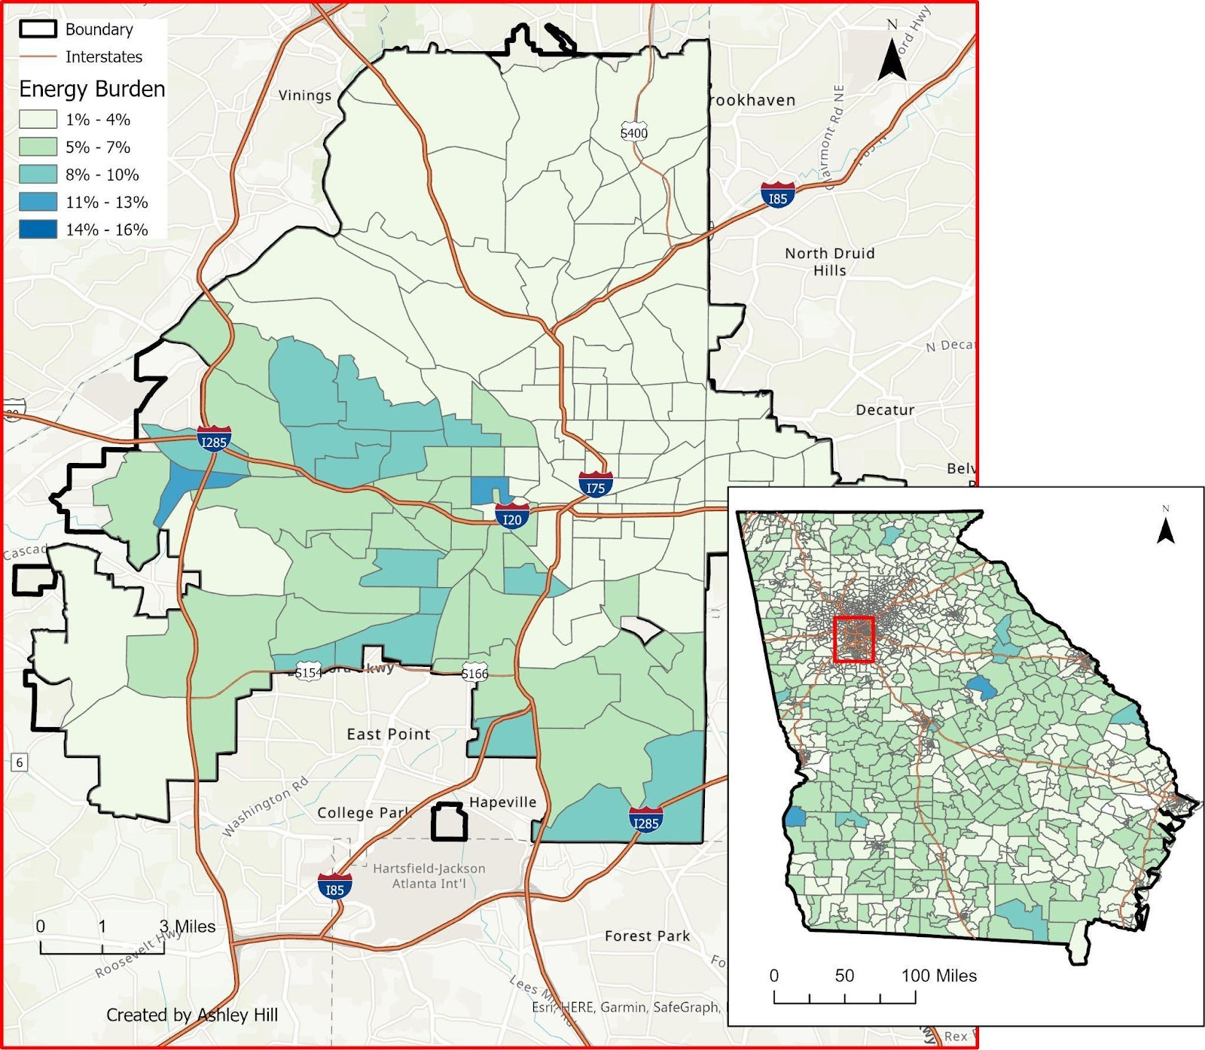
Energy Burden by Census Tract (2018): Alabama and Georgia
Energy Burden by Census Tract (2018), Atlanta, Geogia
A close examination of Atlanta reveals
Clusters of high energy burden, especially in South and West Atlanta
Surrounded by suburban areas with low energy burdens
Notes:
Include in presser
THIS SLIDE HAS ANIMATIONS

Slide 6
Household Energy Bills and Income in Georgia
Electricity dominates energy bills in Georgia
Electricity rates in Georgia are lower than the national average
But electricity bills are higher
Plus:
Household income is lower in Georgia than the US average
Energy bills for households with 0-30% of median income in 2018
Notes:
Include in presser

Slide 7
Energy Burden by Census Tract in Atlanta
100
As Black population increases, so does energy burden
75
50
25
0
Notes:
Include in presser

Slide 8
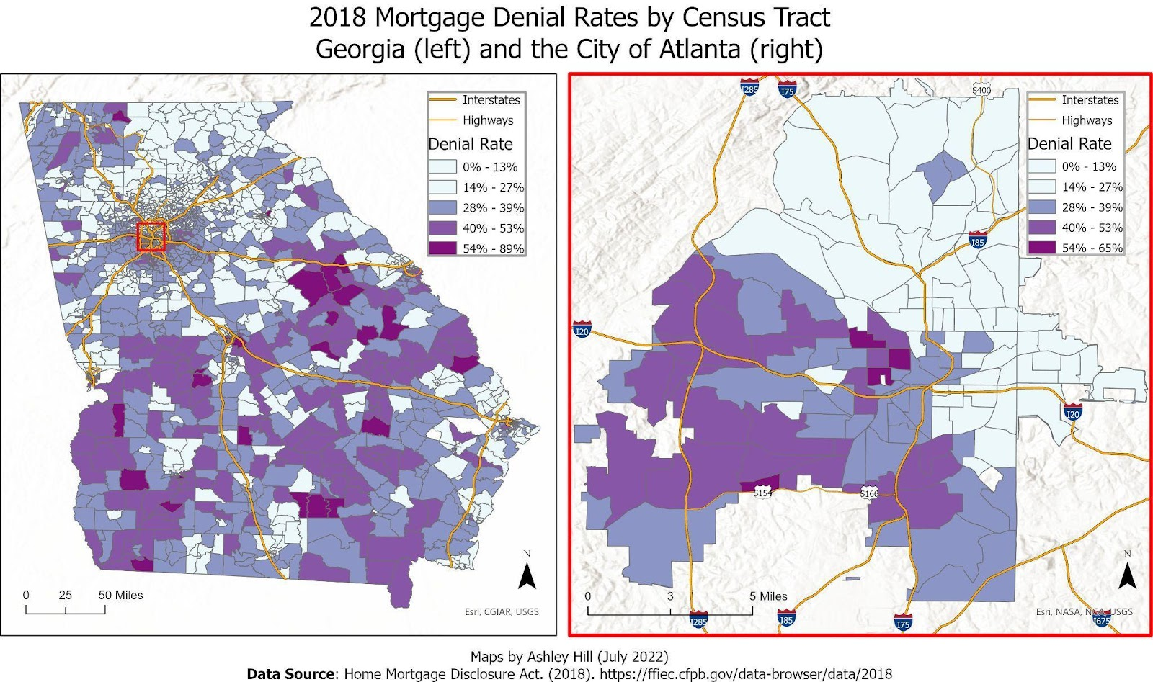
Mortgage Denial Rates by Census Tract (2018), Georgia (left) and Atlanta (right)
Mortgage denial leads to dis-investment in homes
Notes:
Include in presser
As a result of redlining, lending institutions have issued fewer mortgages to predominantly Black communities, creating entrenched segregation, disinvestment and decay that makes it difficult to invest in energy upgrades and retrofits needed to maintain energy-efficient housing, particularly in the deep South.

Slide 9
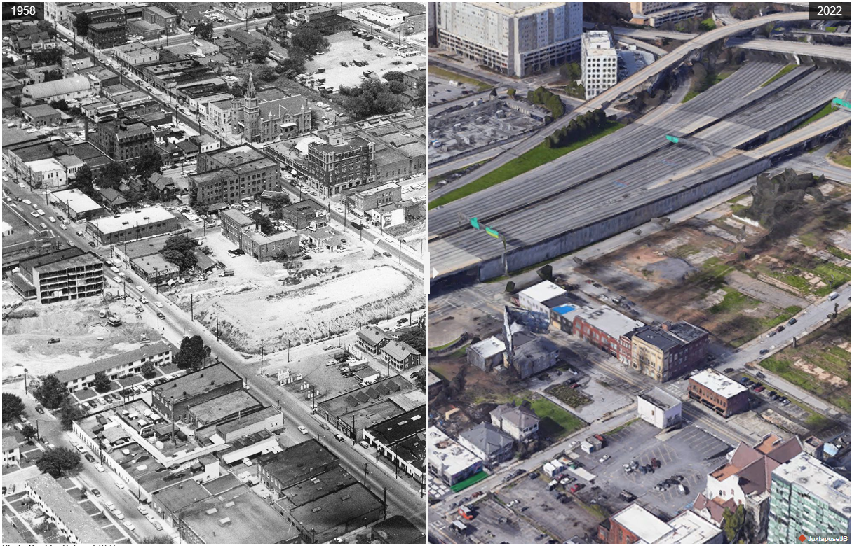
Atlanta’s Auburn Avenue neighborhood was bisected by highway construction (I-75/I-85)
Racism was built into many of the decisions on where to locate freeways.
USDOT Secretary Pete Buttigieg
Before: 1958 (left)
After: 2022 (right)
Notes:
Include in presser

Slide 10
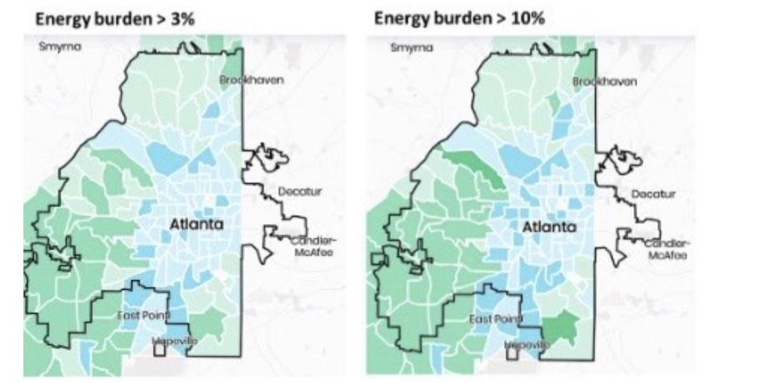
Lack of urban tree canopy contributes to energy burden
Over time, urban tree canopy has been lost in disadvantaged urban settings in Georgia
Urban Tree Canopy
Low Medium
>3% >6% >10%
Energy Burden
Notes:
The census tracts are color-coded as follows -
A light-yellow color means - high tree cover and low energy burden (a good combination, but nowhere seen in the ATL metro area census tracts)
A dark blue - low tree cover and high energy burden.
When you choose a cut-off of 3% or higher, most of the census tracts in Atlanta have light blue and light green colors.
When you choose a cut-off of 10% or higher, two census tracts change the shade to a dark green color (distinguishing them from the other census tracts that showed up earlier as the same color).

Slide 11
Illustrating the causal relationship between race and energy burden
34% Black census tract
Estimated energy burden: 2.6%
90% Black census tract
Estimated energy burden: 6.8%
Threat of climate change
Need for heat adaptation
Stress on vulnerable communities
Comparison of hypothetical Georgia neighborhoods

Slide 12
Vulnerabilities magnify consequences
As household vulnerabilities increase, so do the consequences of high energy burdens.
Notes:
Include in presser

Slide 13
Some conclusions and takeaways
Vulnerable communities are hidden in consolidated metrics
It is hard to identify the effects of race independent of other factors
Energy burden is systemically under-estimated
As household vulnerability increases, consequences are magnified
Justice40 initiatives will make a difference
Improving the energy efficiency of homes is key to reducing energy burdens
Notes:
Include in presser

Slide 14
More good news: federal rebates & tax credits
Notes:
Include in presser

Slide 15
Some good news: federal rebates & tax credits
Notes:
Include in presser

Slide 16
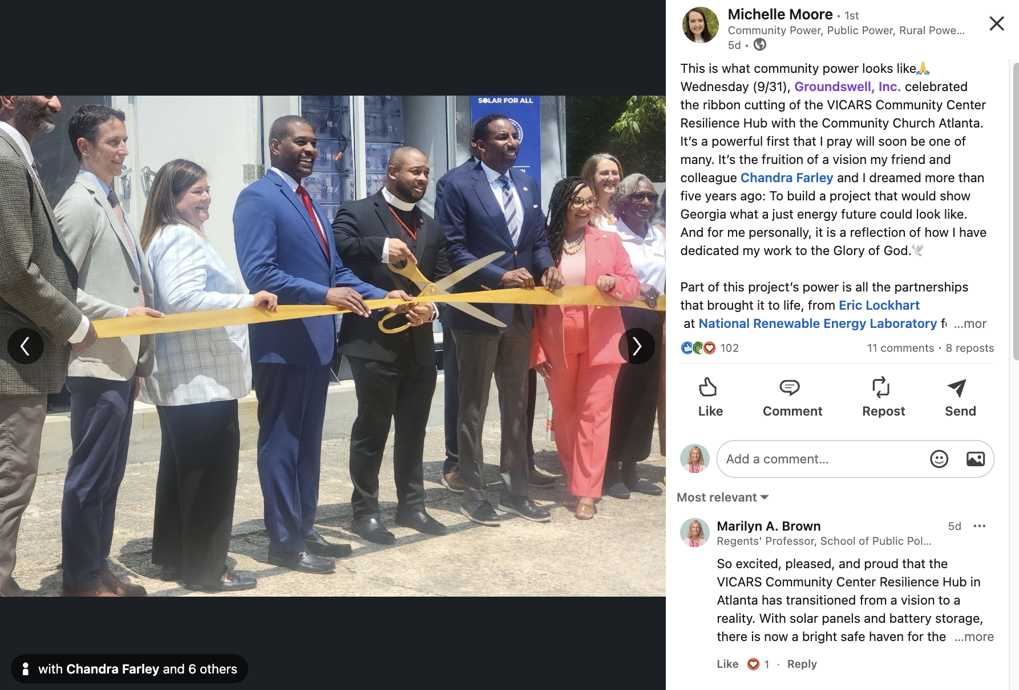
A new resilience hub in Atlanta
Notes:
Include in presser

Slide 17
The first climate action plan for Georgia
Notes:
Include in presser

Slide 18
The “Ecological Fallacy” hides energy poverty
Lowest estimate of energy poverty
Ecological Fallacy:
Our results suggest a ~30% under-estimation of energy burdens in Georgia when aggregated data are used instead of individual household data.
State of GA
GA Counties
GA Census tracts
GA Households
Peer-reviewed citation documenting the ecological fallacy:
Marilyn A. Brown, Snehal Kale, and Ryan Anthony. 2023. “Rescaling energy burden: Using household surveys to examine vulnerabilities and consequences in the Southeastern United States,” Energy Research and Social Science, 106 (December) https://doi.org/10.1016/j.erss.2023.103308
Highest estimate of
energy poverty
Notes:
Include in presser
Data sources: County level and Census tract data from LEAD EB tool, Household data from Georgia Energy and Climate Survey

